Slide 1

Department of Computer Science and Engineering
Project Name : Bitcoin Candlestick Prediction using Deep Neural Networks on Real-time data
Batch ID : C2
Varshitha Alluka (2451-19-733-170) Shreyasi Periketi (2451-19-733-173) Niharika Sakkani (2451-19-733-174)
Under the guidance of Dr. Rajesh Kulkarni, Associate Prof., CSE Dept., MVSREC

Slide 2
Batch ID : C2 Name of the project : Bitcoin Candlestick Prediction using Deep Neural Networks on Real-time Data
OUTLINE
Introduction
Literature Survey
Methodology
Results and Discussions
Conclusions
Development Environment
Q&A

Slide 3
Batch ID : C2 Name of the project : Bitcoin Candlestick Prediction using Deep Neural Networks on Real-time Data
INTRODUCTION
Bitcoin is a cryptocurrency formulated on the concept of a P2P network.
Invented in 2008 by Satoshi Nakamoto and began being used in 2009.
Bitcoin (BTC) has climbed substantially in recent years, reflecting the fact about the amount of rise in its price.
Investors and Traders pay a lot of attention to Bitcoin, but we know very little about its actual nature.
The problem with investing in Bitcoin is its Price Volatility.
Purpose of the project - Price prediction model for determining Bitcoin Price using the following Deep Neural Network models: LSTM and Prophet Models.
Let us understand the question: Can Deep Learning accurately forecast bitcoin prices?

Slide 4
Batch ID : C2 Name of the project : Bitcoin Candlestick Prediction using Deep Neural Networks on Real-time Data
LITERATURE SURVEY
(Alkaya, 2013) presented an optimization technique to predict a stock price measurement using EANN.
(McNally, 2018) used Long Short-Term Memory (LSTM) and Recurrent Neural Network (RNN) networks for predicting the Bitcoin price.
Ferdiansyah (2019) examines both the stock market and bitcoin from various sources to show how to use LSTM to construct a model for prediction. Here, RMSE is insufficient.
(Rasheed, 2020) investigated how LSTM and 1D-CNN accuracy rates were affected by feature extraction using PCA . The results showed that LSTM with PCA performed better.
(Kemalbay G., 2021) suggested creating a deep learning tool depending on Genetic Programming (GP) and evaluation by comparing the outcomes to Seasonal ARIMA and ARCH models. These results demonstrate that the GP performs better than the conventional approaches in forecasting the XU100 index.
A deep-feed forward neural network (DFFNN) was developed and used in the study (Lahmiri & Bekiros, 2021) for the training and predicting of High-Frequency Bitcoin prices.
The authors (Reem K. Alkhodhairi, Shahad R. Aljalhami, and Norah K. Rusayni,2021) bring forth the use of the LSTM and GRU (Gated Recurrent Unit) deep learning algorithms as short-term real-time Bitcoin prediction models.

Slide 5
Batch ID : C2 Name of the project : Bitcoin Candlestick Prediction using Deep Neural Networks on Real-time Data
METHODOLOGY
Most of the prior studies favored using only past (or historical) data and neglected real-time data. This work suggests integrating both past and live data.
Stacked LSTM (Long Short-term Memory) and Prophet models are implemented for Bitcoin price prediction.
Construct a framework that collects an input (which is time series data), pre-processes the given input, trains the models, forecasts the test data, then estimates the bitcoin prices for the next 30 days into the future.
The objective of this project is to visualize the bitcoin candlesticks (i.e., Open, High, Low, and Closing prices) and forecast the future price using historical and real-time data.
The dataset used for the current study is taken from Tiingo. It includes 1826 instances and spans the dates 21-11-2017 to 19-11-2022. 65% of the total dataset is allotted for training and the rest 35% is for testing.
The short-term time interval considered is 1 day and the long-term time interval is 30 days for both models.

Slide 6
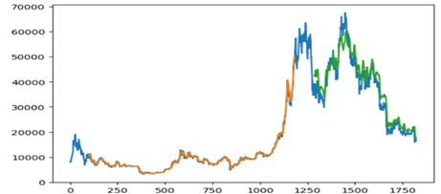
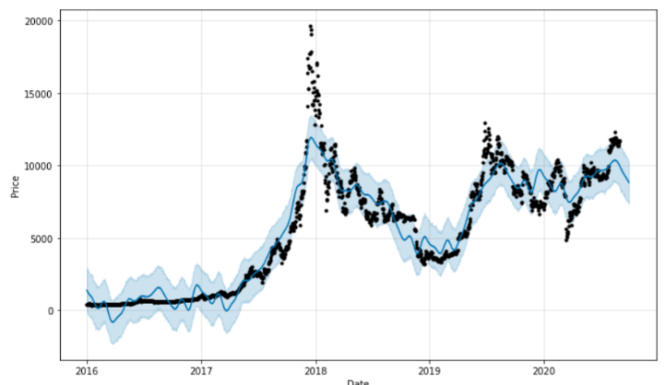
Batch ID : C2 Name of the project : Bitcoin Candlestick Prediction using Deep Neural Networks on Real-time Data
METHODOLOGY
Stacked LSTM Model:
Apply the MinMax scaler.
Data is split into training and testing datasets
Price Prediction on Historical and real data for training and
testing using LSTM is shown in the beside figure.
Prophet Model
The data frame has two columns namely, ds (for date)
and y (for price).
Like LSTM, Data is collected and pre-processed.
The data is fit into the model and results are obtained.
Price Prediction on Historical and real data for training and
testing using Prophet model is shown in the beside figure.

Slide 7
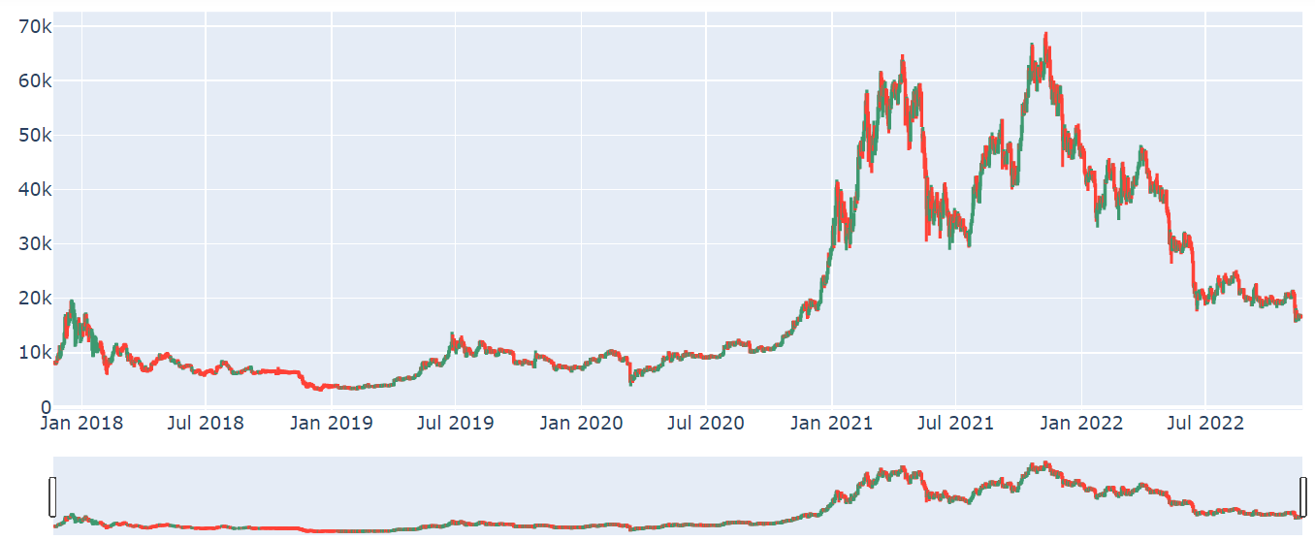
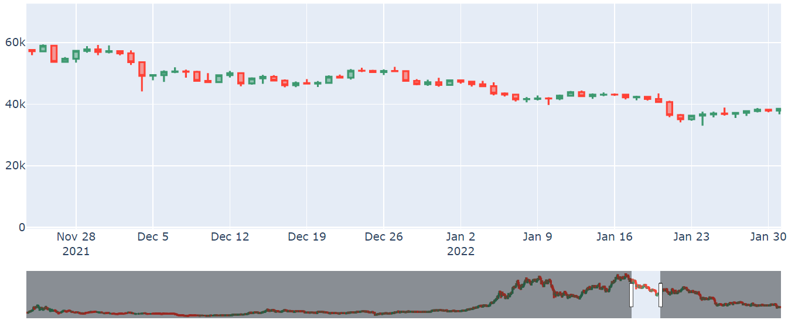
Batch ID : C2 Name of the project : Bitcoin Candlestick Prediction using Deep Neural Networks on Real-time Data
RESULTS AND DISCUSSIONS
Figures below show the Complete and detailed view of Bitcoin Candlesticks with Open, High, Low, and Close prices from November 21, 2017 to October 17, 2022 i.e., data from training and testing datasets.

Slide 8
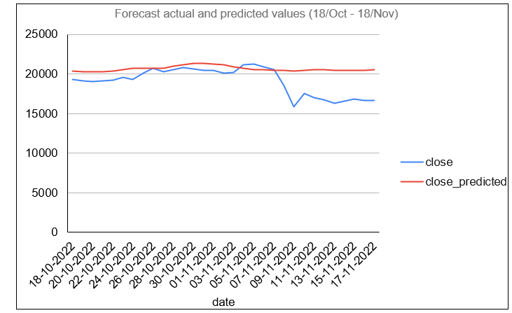
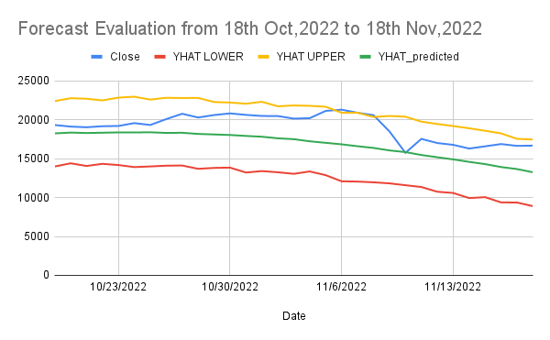
Batch ID : C2 Name of the project : Bitcoin Candlestick Prediction using Deep Neural Networks on Real-time Data
RESULTS AND DISCUSSIONS
Forecasting and visualizing the price of bitcoin takes place between October 18 and November 18, 2022 (30 days).
Forecast of Future Bitcoin prices using the LSTM Model. Forecast of Future Bitcoin price using Prophet Model.

Slide 9
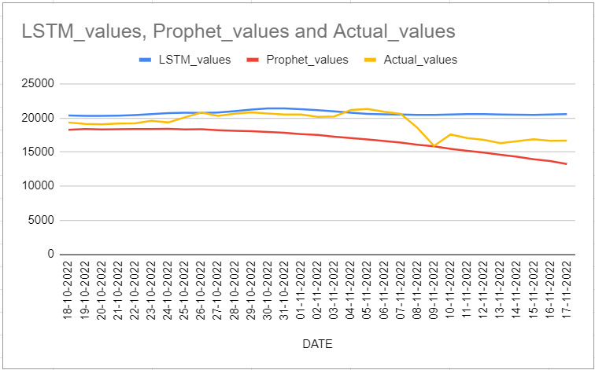
Batch ID : C2 Name of the project : Bitcoin Candlestick Prediction using Deep Neural Networks on Real-time Data
RESULTS AND DISCUSSIONS
Forecasting and visualizing the price of bitcoin price comparison between both the models with actual values from October 18 and November 18, 2022 (30 days).

Slide 10
Batch ID : C2 Name of the project : Bitcoin Candlestick Prediction using Deep Neural Networks on Real-time Data
CONCLUSIONS
The Bitcoin price is very uncertain which means, the price may increase or decrease within the course of a day.
An accurate Bitcoin price prediction would help reduce risk.
Two deep learning techniques are examined in this study. They are: Stacked LSTM and Prophet models.
LSTM produced relatively better results by only providing one output per instance.
In the future, we plan to use numerous deep learning models and using sophisticated engineering techniques, cutting-edge prediction algorithms, and other evaluation metrics.

Slide 11

Batch ID : C2 Name of the project : Bitcoin Candlestick Prediction using Deep Neural Networks on Real-time Data
Background on Development environment : Specific Software/APIs to be used
This project is developed using the Python programming language in a Windows 10 environment on a machine with an Intel Core i5 processor running at 2.90GHz.
In this project, the Jupyter notebook Integrated Development Environment (IDE) is used to write the code. Jupyter notebook is a Python programming language integrated development environment (IDE) created by Fernando Perez and Brian Granger in 2014.
Jupyter Notebook (formerly IPython Notebook) is a web-based interactive computational environment for creating notebooks documents. Jupyter Notebook is built using several open-source libraries, including IPython, ZeroMQ, Tornado, jQuery, Bootstrap and MathJax. A Jupyter Notebook document is a browser-based REPL containing an ordered list of input/output cells which can contain code, text, mathematics, plots and rich media. Underneath the interface, a notebook is a JSON document, following a versioned schema, usually ending with the ".ipynb" extension.
The main parts of the Jupyter Notebooks are: Metadata, Notebook format and list of cells. Metadata is a data Dictionary of definitions to set up and display the notebook. Notebook Format is a version number of the software. List of cells are different types of Cells for Markdown(display), Code( to execute), and output of the code type cells.
.

Slide 12
Batch ID : C2 Name of the project : Bitcoin Candlestick Prediction using Deep Neural Networks on Real-time Data
Questions & Answers
(To be answered by students)

